Slide 1
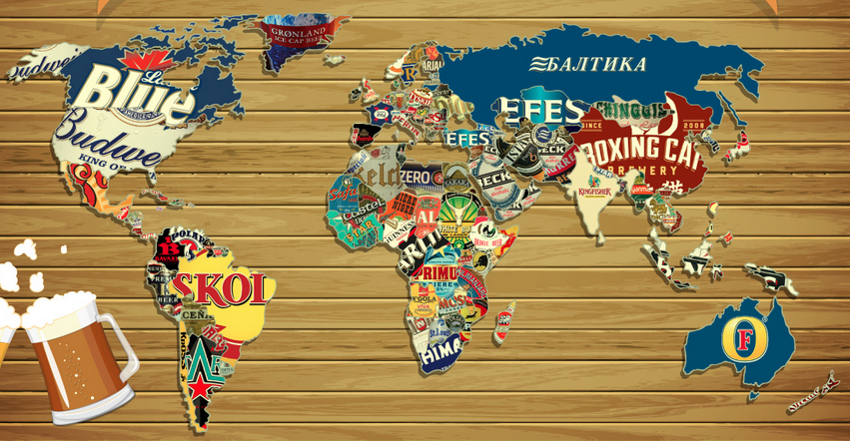
One
at a Time…
Alyssia Smith,
Eilish Boyd,
and Leticia Salazar
I P A

Slide 2
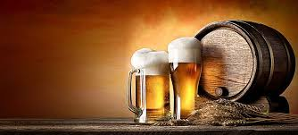
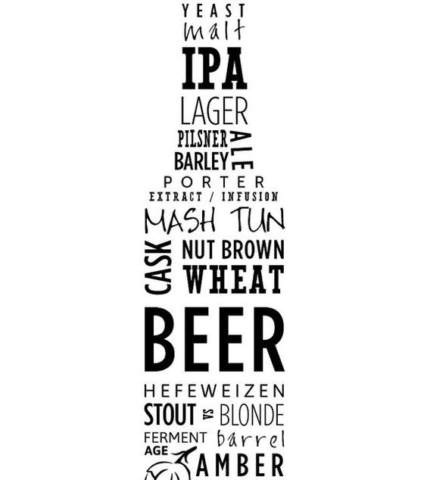
Beer in the United States
Breweries owe it all to beer lovers around the world. We all have our favorite kind but …
What is the most popular beer style in the United States?
Where are these Breweries located in NY?

Slide 3
All your questions will be answered but first...

Slide 4
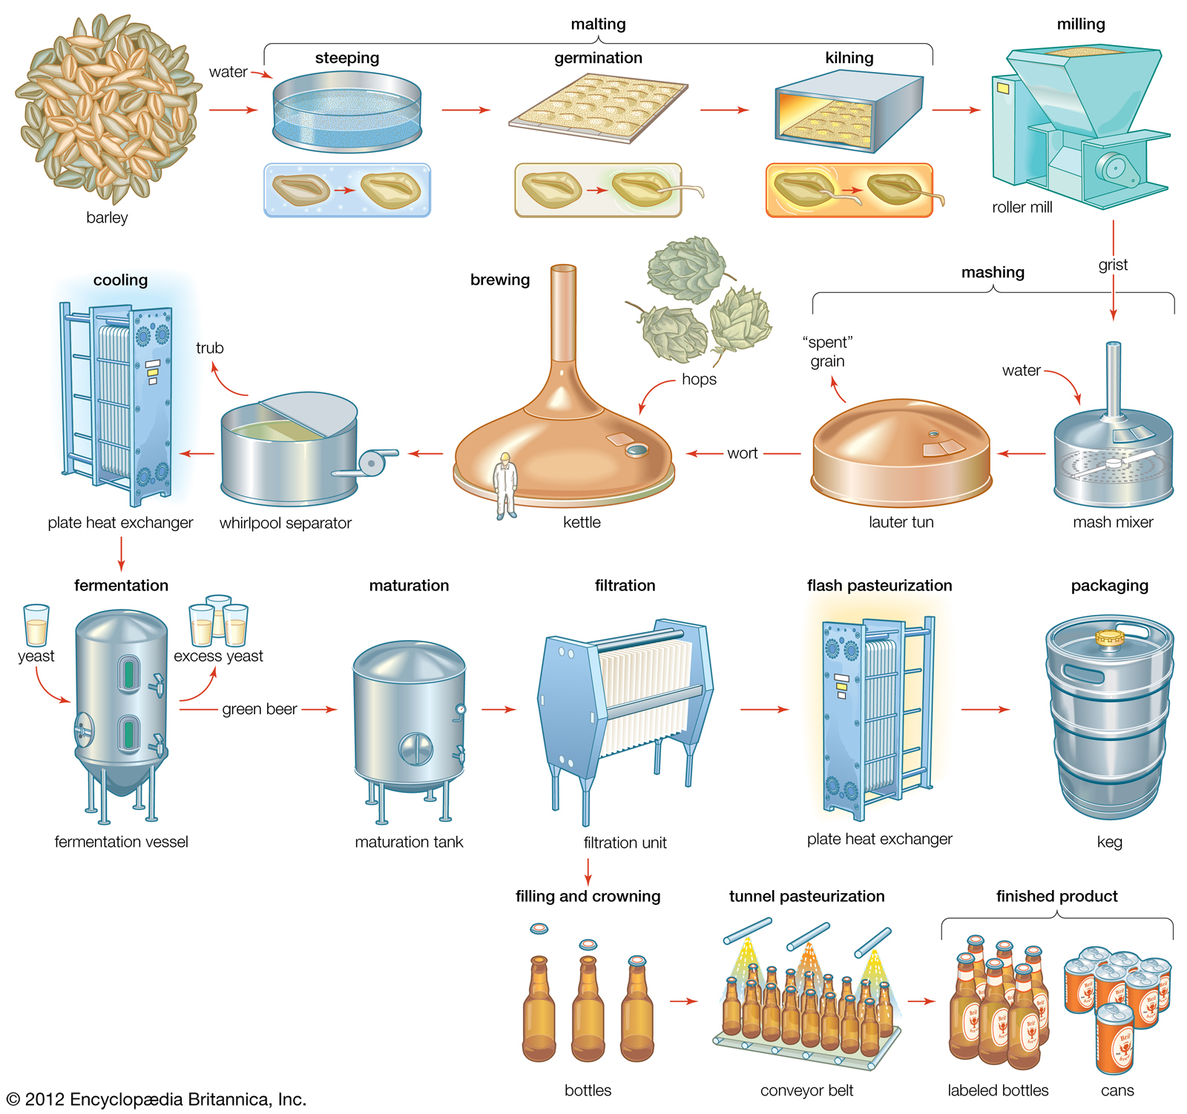
How is beer made?
Ingredients
Barley
Hops
Water
yeast
Malthing
Isolate the enzymes in the grains needed for brewing
Mashing
Grains are steeped in hot water so that the enzymes are broken down and the sugars are released.
Boiling
Hops and other spices are added
Fermentation
Yeast and Sugar are added
Bottling and Aging

Slide 5
Types of Breweries
Micro Brewery: produces fewer than 15,000 barrels of beer annually
Brewpub: a bar that is owned by a brewery and serves their beer directly to consumers.
Only in California, New York and Texas
Large brewery: has an annual beer production of over 6,000,000 barrels

Slide 6
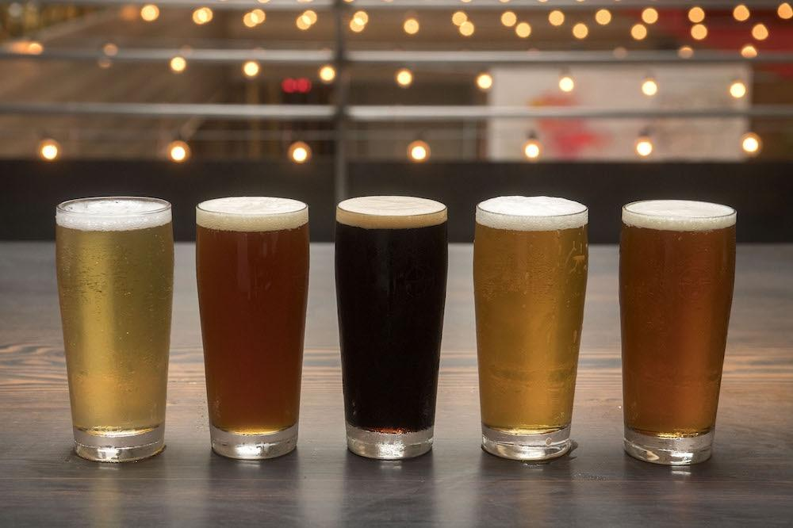
Beers in the United States

Slide 7
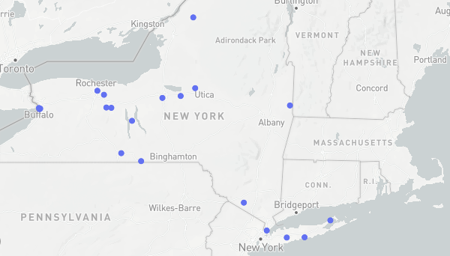
Insights
Average IBU(International Bitterness Units): 21.06
Average ABV(Alcohol by Volume): 4.78
Average SRM(Standard Reference Method): 10.65
Average OG(Original Gravity): 0.45
Average FG(Final Gravity): 0.77
There are 558 Breweries in the United States, 16 of which are in New York State.
The top state with the most breweries is Colorado
North Dakota, South Dakota, West Virginia, and the District of Columbia have 1 brewery each.
Most popular beer is American IPA and American Pale Ale

Slide 8
THANKS!
Any questions?

